Slide 1
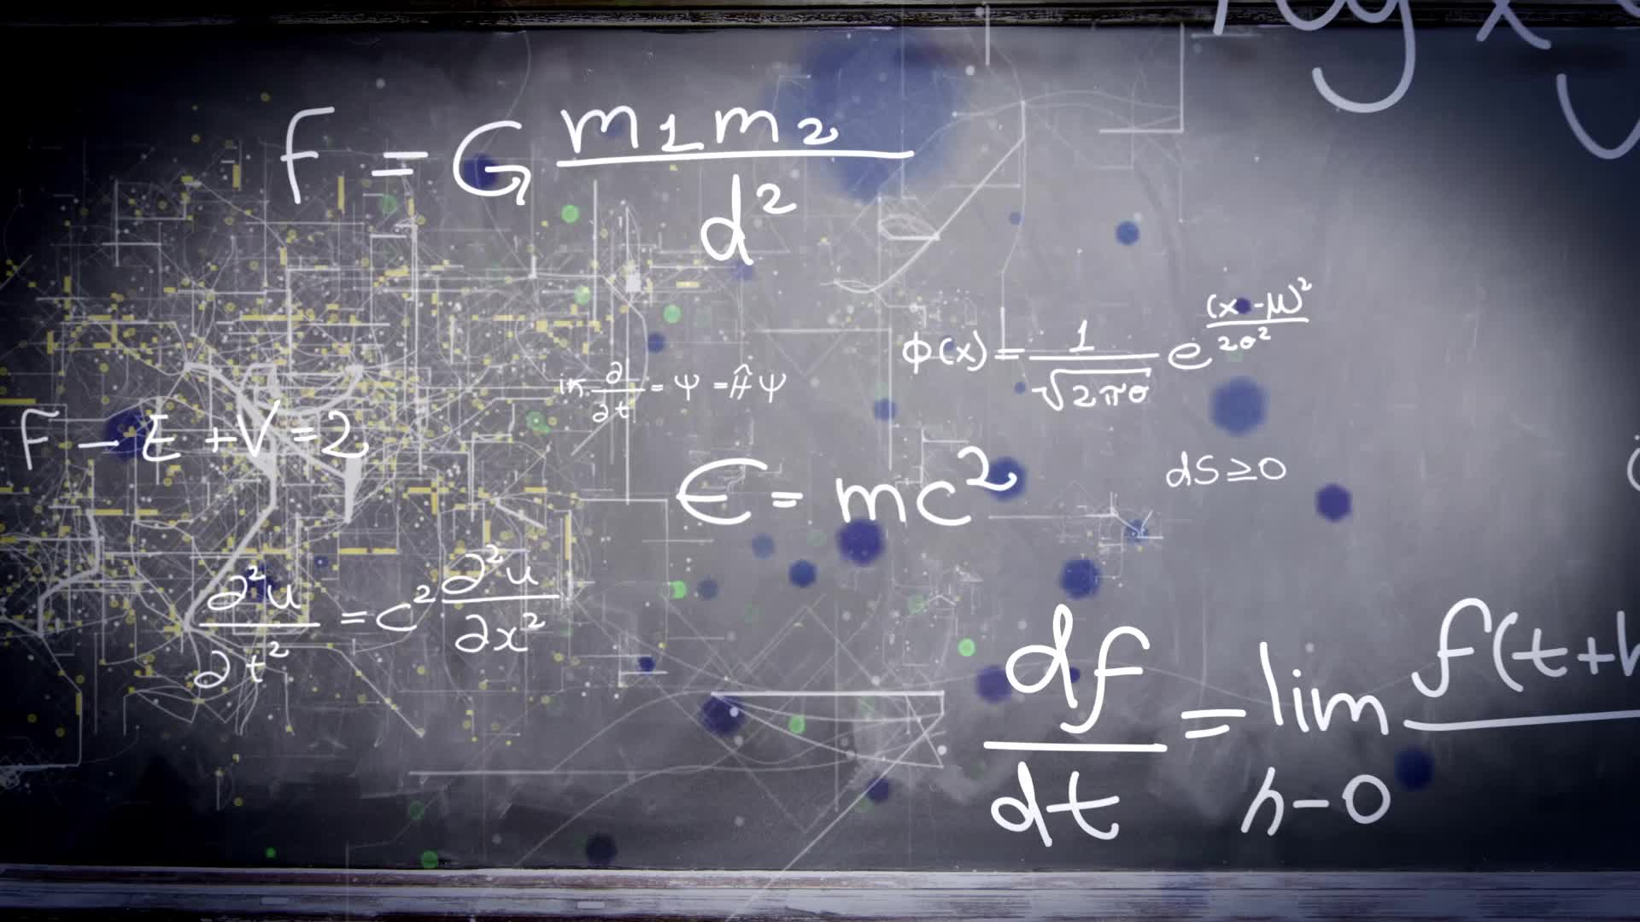
Chapter 2.5:
Implicit Differentiation
HONORS CALCULUS/CALCULUS

Slide 2


















Find the derivative of the following equation with respect to $x$:
$$x^{2}−2y^{3}+4y=2$$

Slide 3


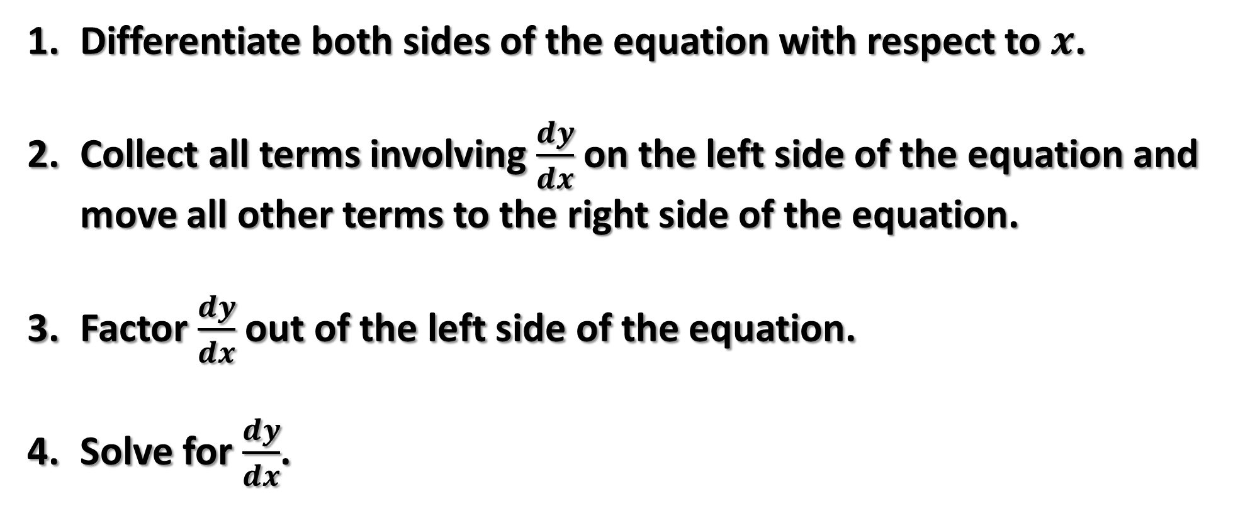





Implicit Differentiation
Differentiate both sides of the equation with respect to $x$.
Collect all terms involving $\frac{dy}{dx}$ on the left side of the equation and move all other terms to the right side of the equation.
Factor $\frac{dy}{dx}$ out of the left side of the equation.
Solve for $\frac{dy}{dx}$.

Slide 4








Differentiate the following with respect to $x$:
$$3x^{2}$$
$${2y}^{3}$$
$$x+3y$$
$$xy^{2}$$

Slide 5









Find the derivative of the following equation with respect to $x$:
$$x^{2}−2y^{3}+4y=2$$

Slide 6






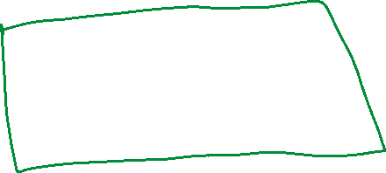









Find the derivative of the following equation with respect to $x$:
$$y^{3}+y^{2}−5y−x^{2}=−4$$

Slide 7
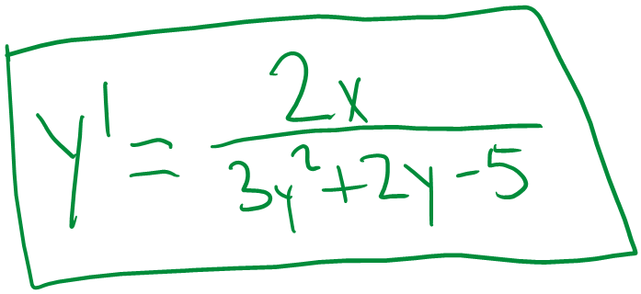









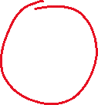


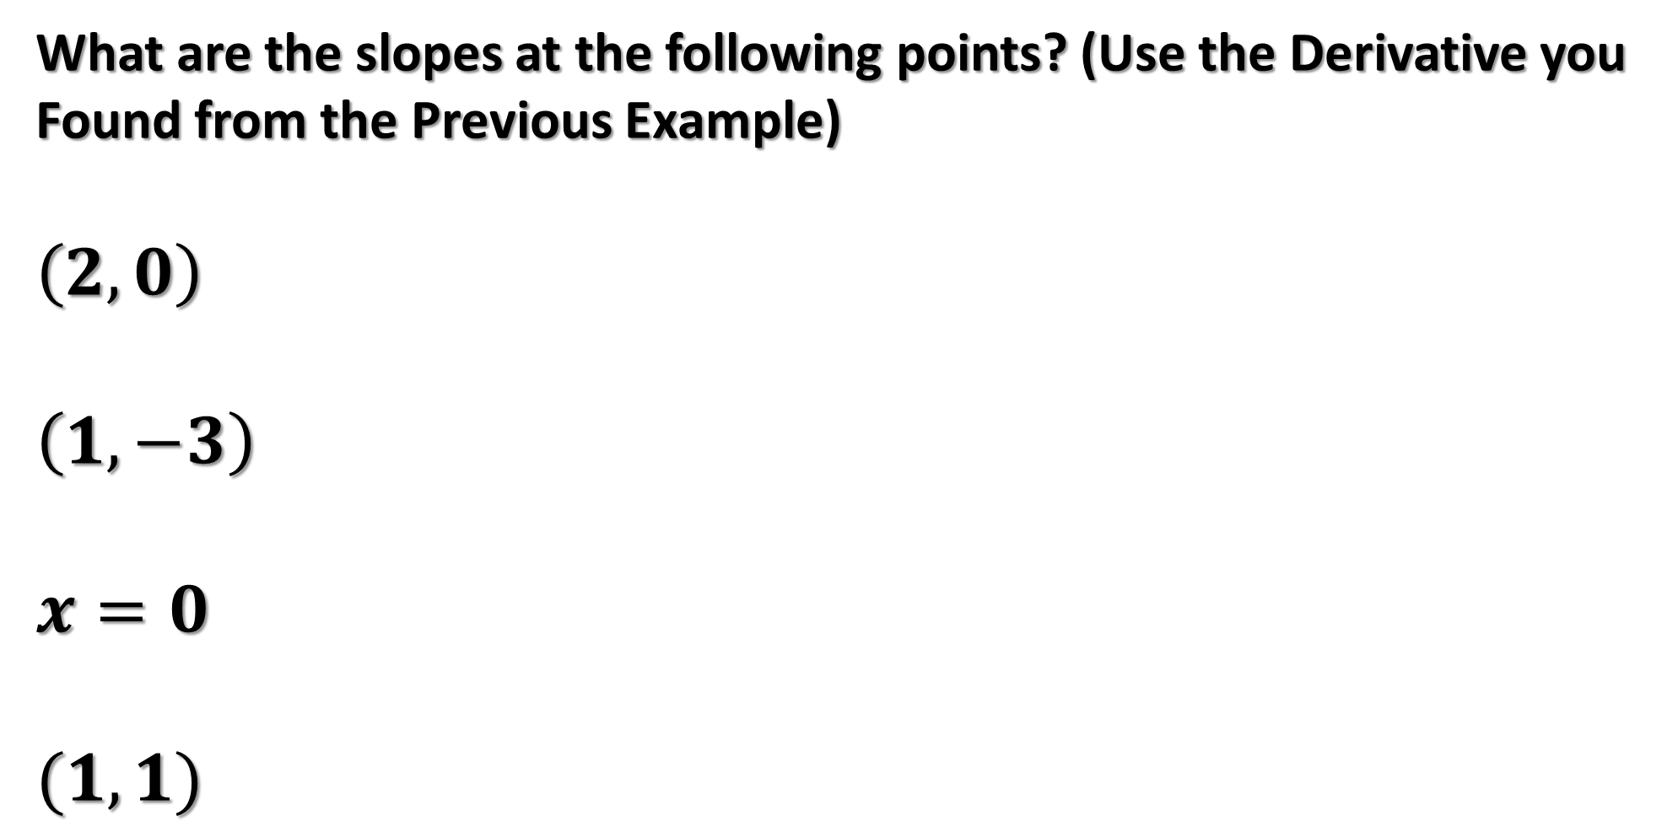


What are the slopes at the following points? (Use the Derivative you Found from the Previous Example)
$$\left(2, 0\right)$$
$$\left(1,−3\right)$$
$$x=0$$
$$(1,1)$$

Slide 8



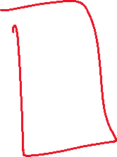


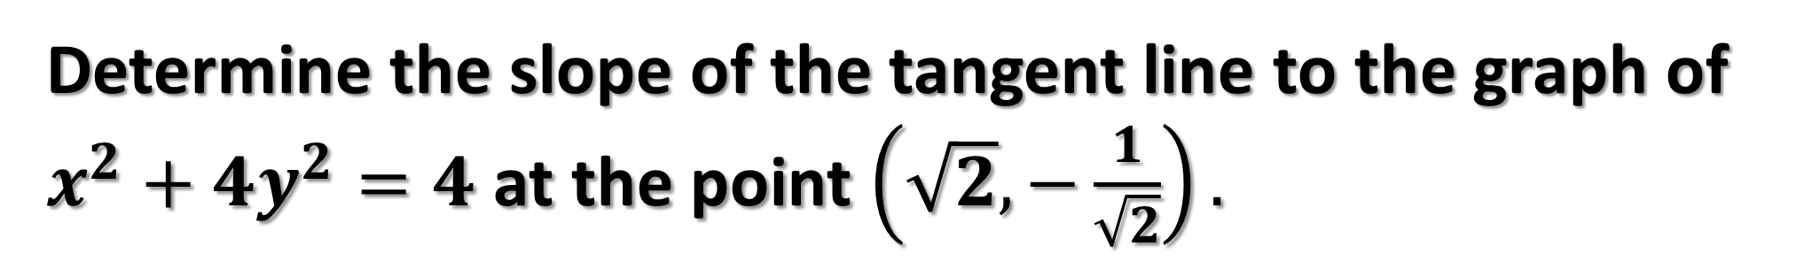



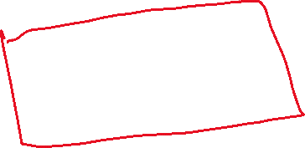



Determine the slope of the tangent line to the graph of $x^{2}+{4y}^{2}=4$ at the point $\left(\sqrt{2}, −\frac{1}{\sqrt{2}}\right).$

Slide 9



Find the derivative of the following equation with respect to $x$:
$$siny=x$$

Slide 10









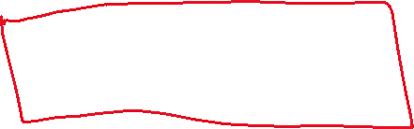

Find the derivative of the following equation with respect to $x$:
$$xsiny=ycosx$$

Slide 11









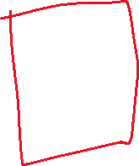


Find the second derivative of the following equation with respect to $x$:
$$x^{2}+y^{2}=25$$

